Slide 1
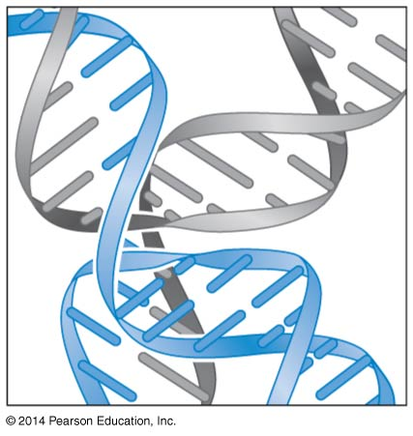
Homologous Recombination
BT 451
Chapter 11

Slide 2
Recombination
Physical exchange of DNA sequence between the chromosomes
Types of recombination
Homologous recombination (HR)
Conservative site specific recombination (CSR)
Transposition (Tp)

Slide 3
Importance of Homologous recombination
Essential cellular process catalyzed by enzymes specifically made and regulated for this purpose.
Provide genetic variation
Allows cells to retrieve sequences lost through DNA damage by replacing the damaged chr.
Provides a mechanism to restart stalled or damaged replication forks
Special types of recombination regulate the expression of some genes
Provide explanation for genetic processes
Development of methods to manipulate genes e.g. knock out and transgenic organisms

Slide 4
DNA breaks are common and initiate recombination
A single DSB in the E. coli chr is lethal to a cell that lacks the ability to repair it
In most cells, HR is the major mechanism for repair of DSBs
In bacteria, major role of HR is to repair DSBs
An unrepaired nick in one strand will lead to collapse of a passing replication fork. Also, a fork-stopping lesion can stall replication.

Slide 5
The broken ends will initiate recombination with a homologous DNA molecule that will heal the break
Also, HR promotes genetic exchange in bacteria. This exchange occurs between the chr of one cell and the DNA that enters that cell via phage-mediated transduction or cell-cell conjugation
In eukaryotes, HR is critical for repairing DNA breaks and collapsed replication forks

Slide 6
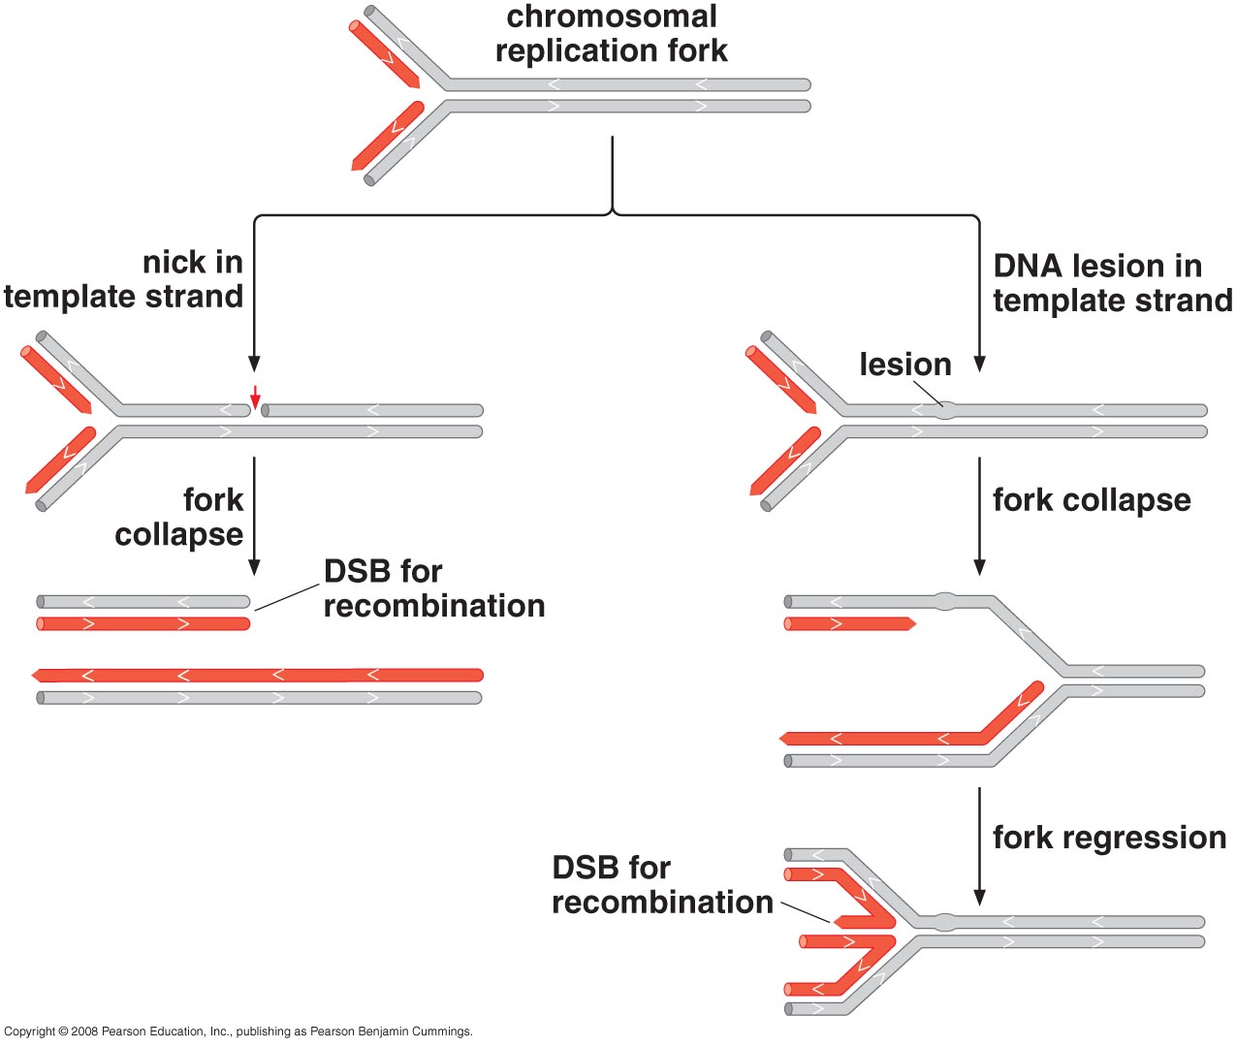
Damage in the DNA template can lead to DSB formation during replication

Slide 7
Models of Homologous Recombination
Elegant early experiments using heavy isotopes of atoms incorporated into DNA provided the first molecular view of the process of HR
Key steps of HR present in these models include:
Alignment of two homologous DNA molecules (can have variants ; alleles)
Introduction of breaks in the DNA (processed to produce ssDNA in each duplex.
Formation of initial short regions of base pairing between the two recombining DNA molecules (called strand invasion step) → regions of new duplex DNA are generated (heteroduplex DNA)

Slide 8
After strand invasion, the two DNA molecules become connected by crossing DNA strands (Holliday junction).
A Holliday junction can move along the DNA by the repeated melting and formation of base pairs. Each time the junction moves, base pairs are broken in the parental molecules while identical base pairs are formed in the recombination intermediate (called branch migration)
5. Cleavage of the Holliday junction (called resolution)

Slide 9
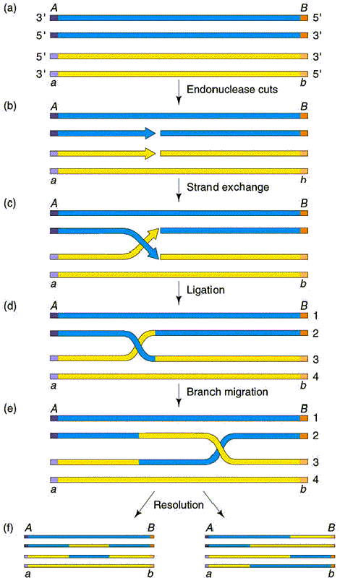
Holliday Model
----Aligned homologous duplexes
NICK
----single stranded breaks in each duplex
----strand invasion

Slide 10
Holliday junction
----Branch migration

Slide 11
Products of Holliday Recombination
Non-crossover “patch” product
crossover “Splice” product

Slide 12
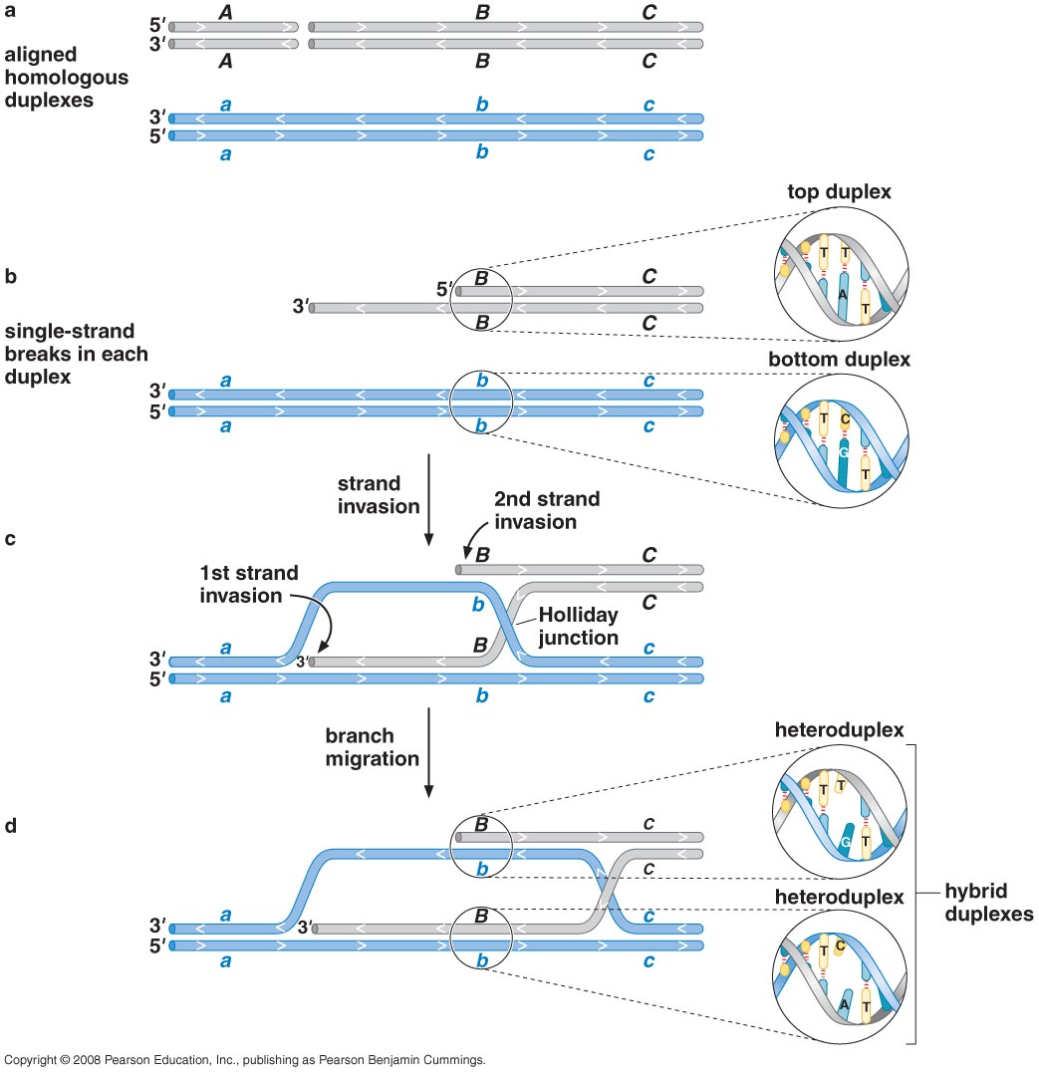
Holliday model through the steps of branch migration
Strand-exchange proteins: enzymes that
Catalyze strand invasion

Slide 13
Resolving Holiday junctions is a key step to finishing genetic exchange
To make the cut sites easier to visualize, the Holliday junction is rotated to give a square, planar structure with no crossing strands
The two strands with the same sequence and polarity must be cleaved.

Slide 14
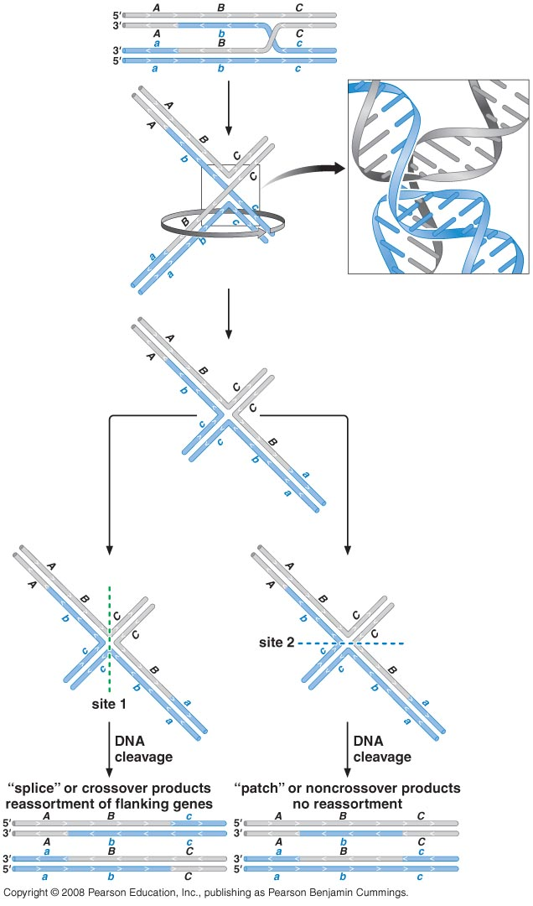
Holliday junction cleavage

Slide 15
Notes:
The cut site 1 occur in the two DNA strands that are composed entirely of DNA from one of the two parental DNA molecules

Slide 16
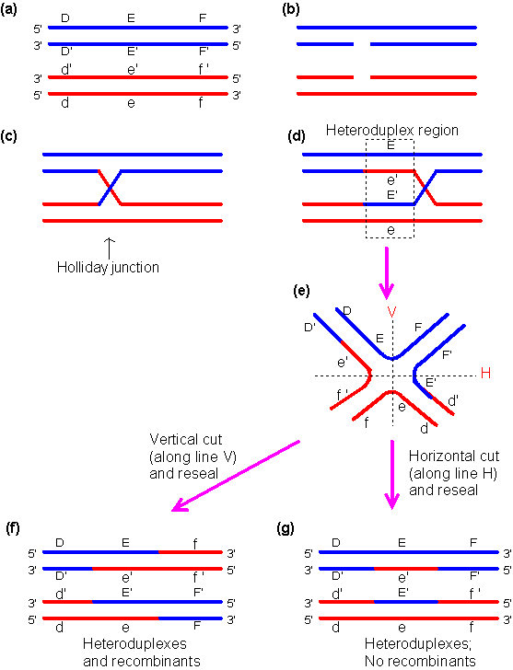

Slide 17
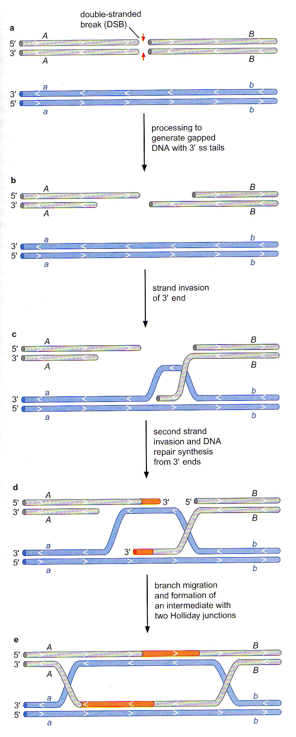
DSB repair model

Slide 19
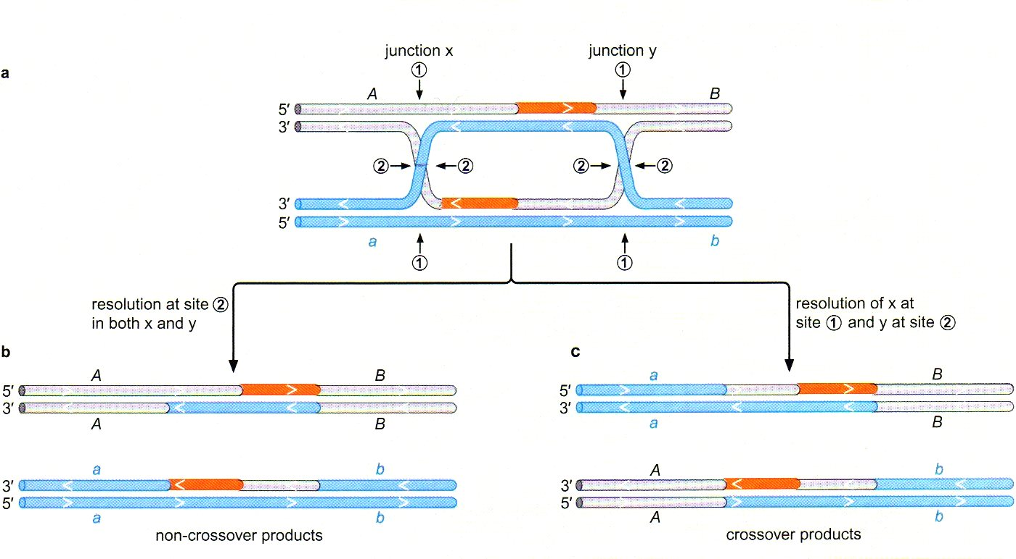
How to resolve a recombination intermediate with two Holliday junctions
Notes:
If both junctions are cleaved in the same way, then noncrossover products will be generated
When the two Holliday junctions are cleaved using different sites, then the crossover products are generated

Slide 20
Homologous Recombination Protein Machines

Slide 21
Protein Machines
All organisms encode enzymes needed for recombination
E.coli uses the RecBCD pathway (DSB repair, conjugation and transduction)
Other Enzymes needed include:
DNA polymerase
Topoisomerase
ligase

Slide 22
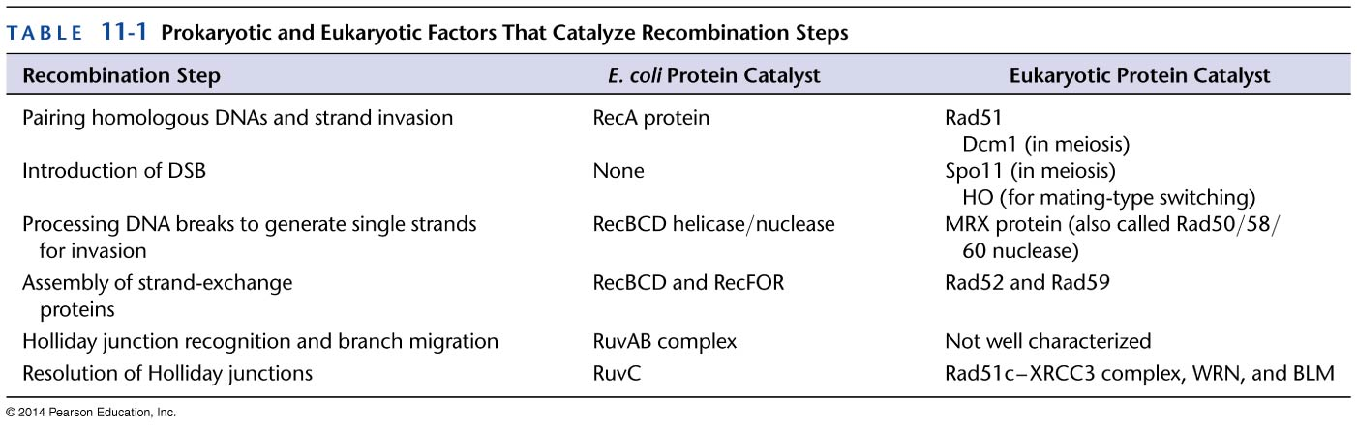
Protein Machines
Notes:
No protein that introduces DSB in bacteria
Breaks generated as a result of DNA damage or failure of replication fork
Or during genetic exchange rxns such as phage-mediated transduction, the infecting DNA segment carries broken DNA ends

Slide 23
Steps of the RecBCD pathway
DSB results from DNA damage / Failure of replication fork (E.coli)
RecBCD processes DNA to generate ssDNA
RecA promotes strand invasion
RuvAB complex catalyzes branch migration
RuvC catalyzes Holliday junction resolution

Slide 24
RecBCD helicase/ nuclease processes broken DNA molecules for recombination
Processes broken DNA molecules to generate ssDNA regions
Helps load the RecA strand-exchange protein onto ssDNA
Multiple enzymatic activities of RecBCD provides a means for cells to choose whether to recombine with or destroy DNA molecules that enter a cell.
3 proteins; Rec B, Rec C, Rec D
Has both helicase and nuclease activities
The activities of RecBCD are controlled by specific DNA sequences called chi sites (Χ)

Slide 25
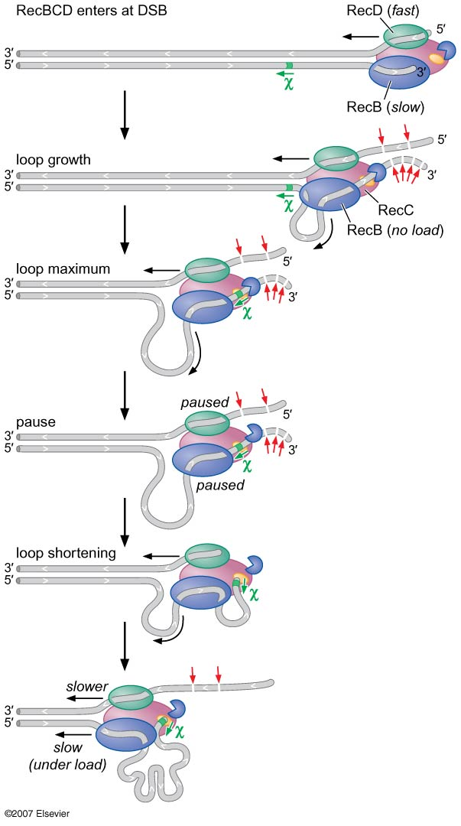
RecBCD enters the DNA at the site of the DSB and moves along the DNA, unwinding the strands
The RecB and RecD subunits (use ATP to melt DNA)
RecB is a 3 ' to 5' helicase and has a multifunctional DNA nuclease domain while RecD is a 5' to 3' helicase
RecC functions to recognize the chi sites
Upon encountering the chi sequence, the nuclease activity of the RecBCD is altered (due to inactivation of RecD)
It is no longer cleaves the DNA with 3' to 5' polarity but cleaves the other strand more frequently
As a result, a duplex DNA molecule is converted into one with 3' single stranded extension
This structure is ideal for assembly of RecA and initiation of strand exchange
Notes:
Chi sites function only in one orientation
To ensure that RecA rather than SSB binds the ssDNA tails RecBCD interacts directly with RecA and promotes its assembly
This loading activity involves a direct protein-protein interaction between the nuclease domain of RecB and RecA

Slide 26
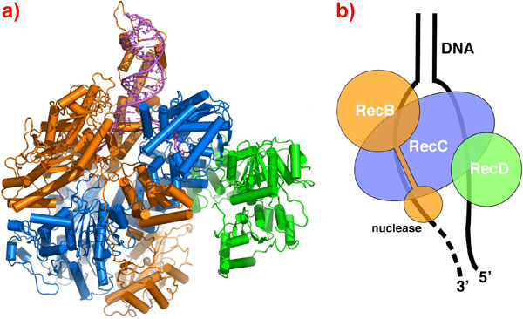

Slide 27
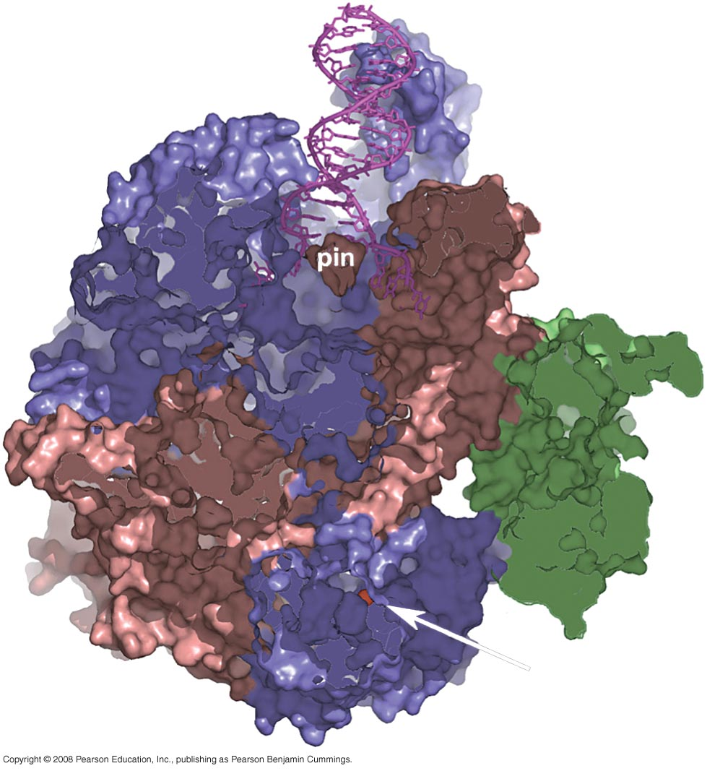
The DNA enters from the top, it encounter a pin structure protruding from RecC that splits the helix and guides the two strands to the two motors with in the enzyme
The RecC channels the 3' strand to the RecB motor and the 5 ' strand to the RecD motor.

Slide 28
Crossover hot spot instigator (Chi Sites)
Specific sequence of DNA 5'GCTGGTGG 3'
Highly overrepresented in E.coli genome (1009 sites compared to 80 predicted sites)
The ability of chi sites to control the nuclease activity of RecBCD also helps bacterial cells protect themselves from foreign DNA that may enter via phage infection or conjugation.
Increase frequency of recombination 10X
Destroy foreign DNA.
Alter the RecBCD function.
Notes:
The DNA between the DSB and the chi site is cut into small pieces by the enzyme and is not available for recombination
The sequences met by RecBCD after its encounter with chi are preserved in a recombinogenic single stranded form and specifically loaded with RecA
Because of overrepresentation, E.coli DNA that enters an E.coli cell is likely to be processed by RecBCD in a maner that generates the 3’ ssDNA tails and thus to be activated for recombination
DNA from another species will lack frequent chi sites. RecBCD action on this DNA will lead to its extensive degradation rather than activation for recombination

Slide 29
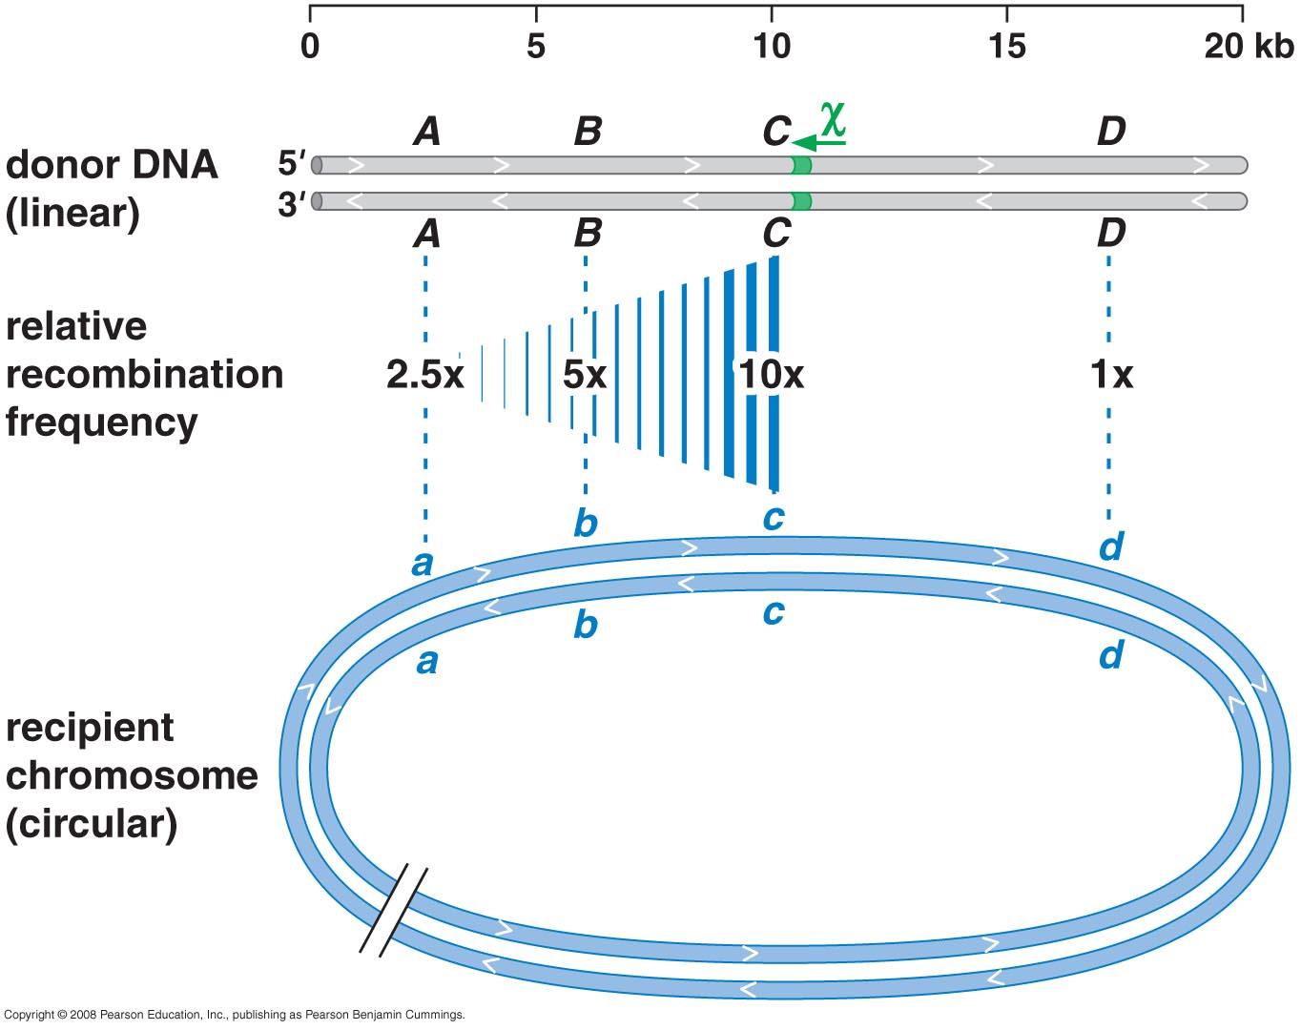
Polar action of chi

Slide 30
RecA protein assembles on ssDNA and promotes strand invasion
A member of the strand-exchange proteins that catalyze pairing of homologous DNA molecules.
The DNA pairing and strand exchange activities of RecA can be observed using simple DNA substrates in vitro.
Important features of these molecules (RecA):
1. complementarity between the partner molecules
2. a ssDNA on at least one molecule.
3. presence of DNA end within the region of complementarity enabling the DNA strands in the newly formed complex to intertwine

Slide 31
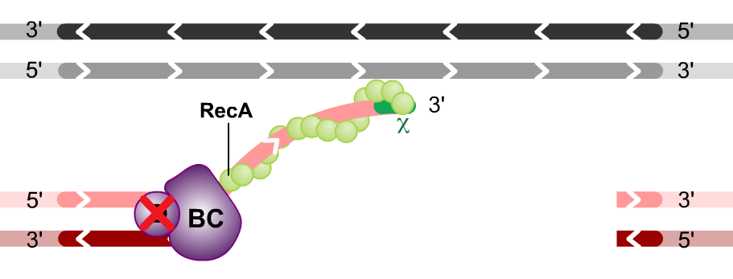
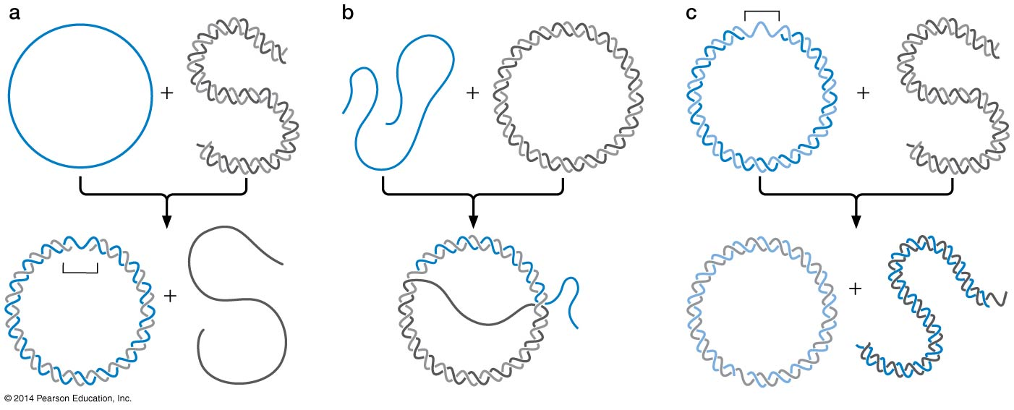
Substrates for RecA strand substrate

Slide 32
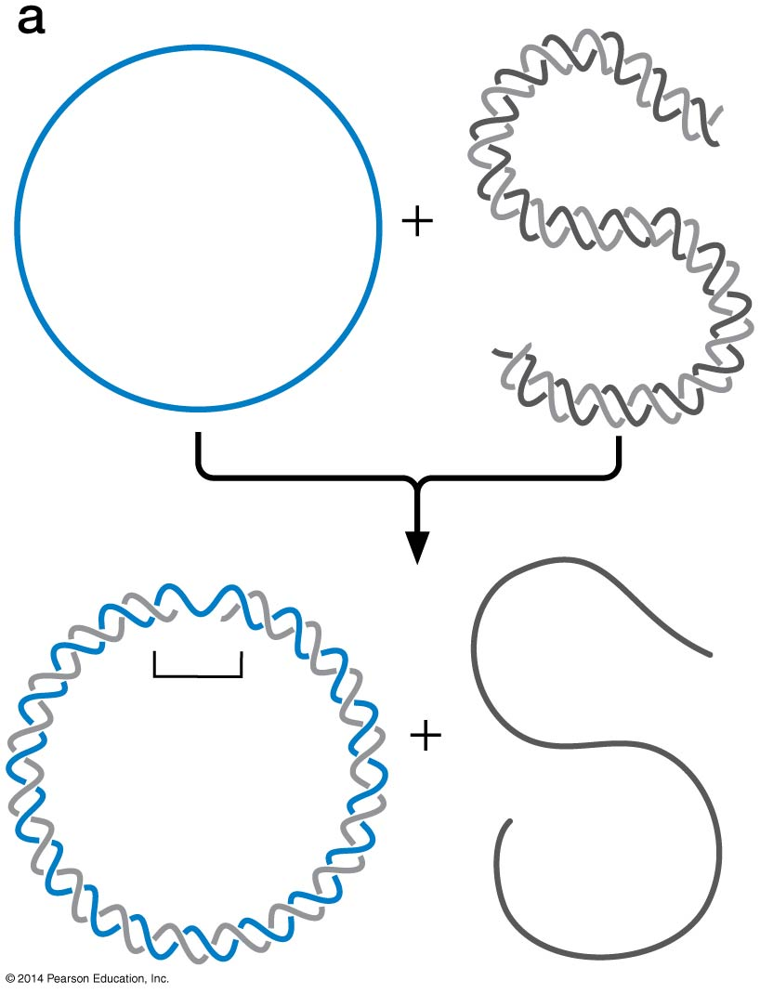
Figure 11-8a
Notes:
32
Figure 11-8a

Slide 33
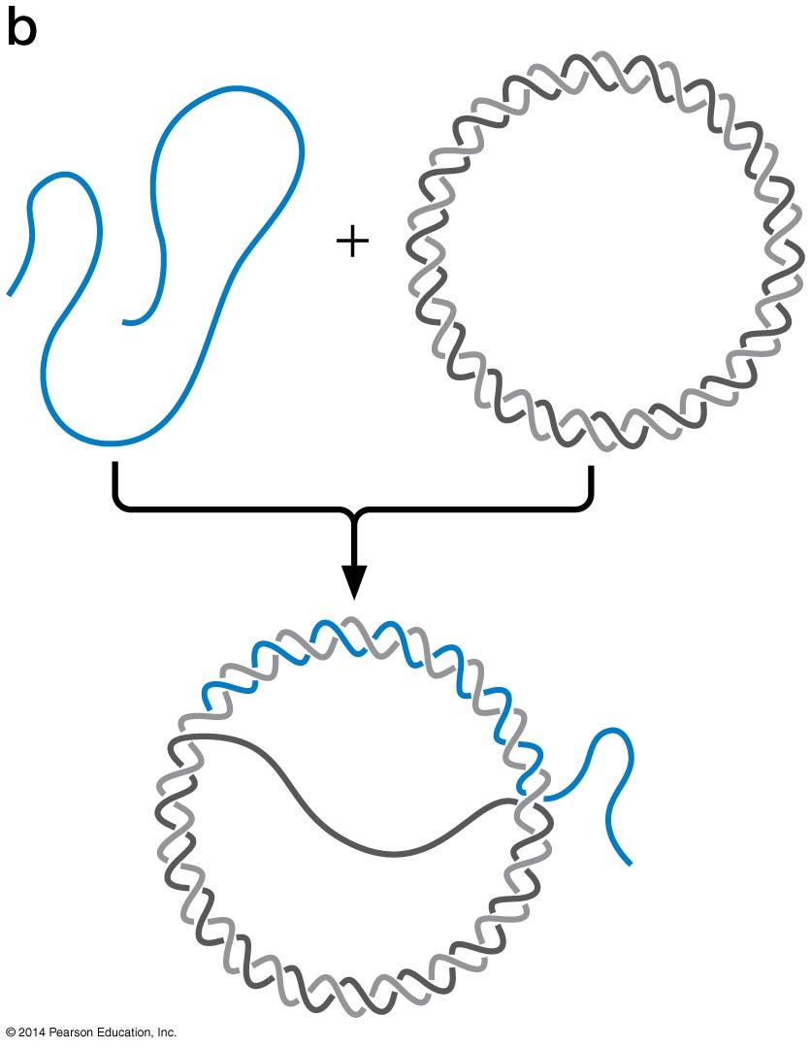
Figure 11-8b
Notes:
33
Figure 11-8b

Slide 34
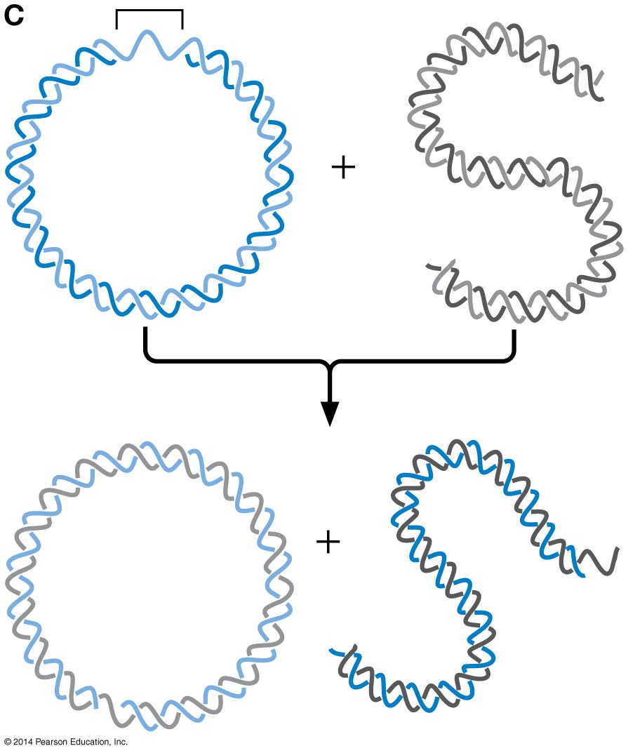
Figure 11-8c
Notes:
34
Figure 11-8c

Slide 35
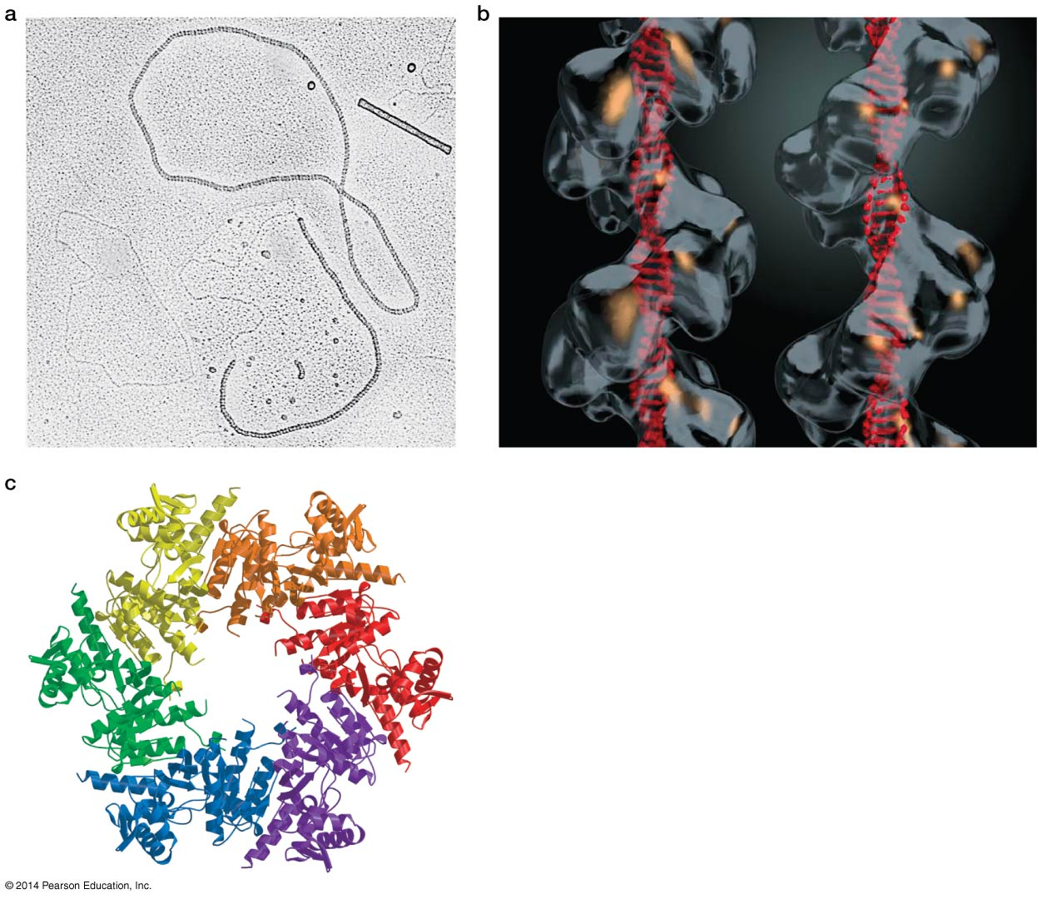
The active site of RecA is a protein-DNA filament (huge and variable in size, 100 subunit and 300 nucleotides of DNA)
Filament can accommodate up to 4 strands of DNA (1 and 3 are most common called Joint Molecule)
DNA is highly extended compared to uncoated ssDNA or B-DNA
Distance between bases is ~ 5Å compared to 3.4Å.
Length of DNA is extended ~ 1.5 fold

Slide 36
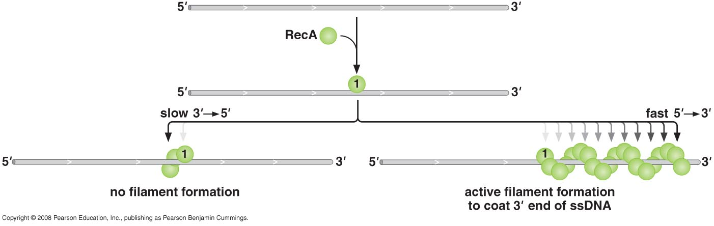
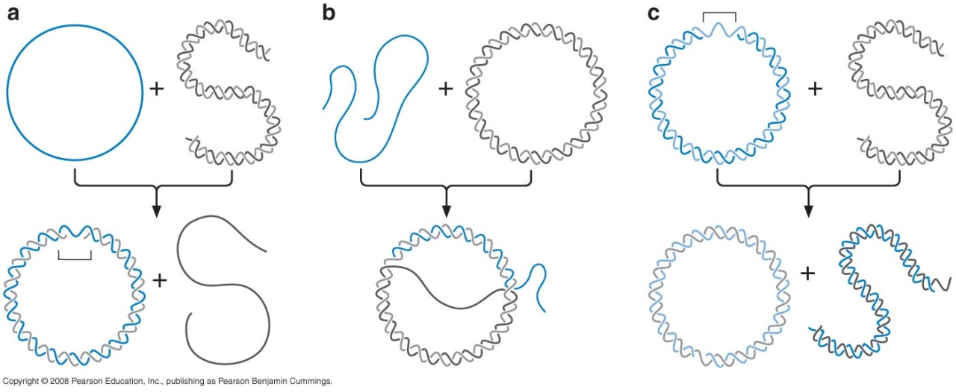
Polarity of RecA assembly
To form a filament, subunits of RecA bind cooperatively to DNA much more rapid on ssDNA than dsDNA.
Filament grows in the 5' to 3' such that a DNA strand that terminates in 3' ends is most likely to be coated by RecA.

Slide 37
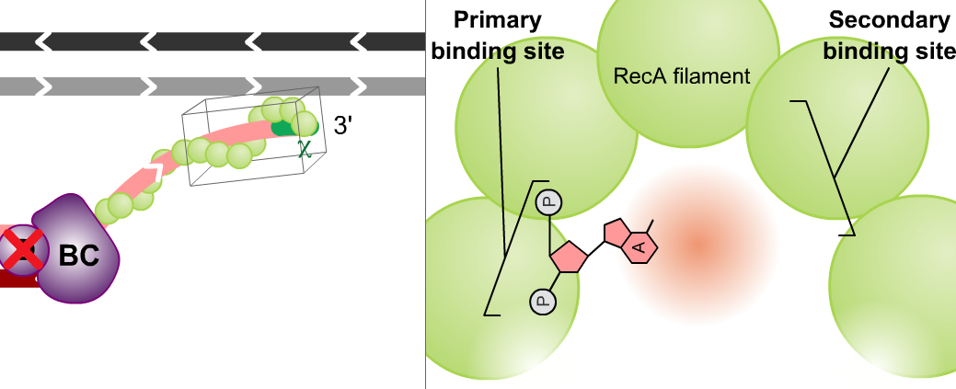
RecA searches for bp complementarity
1° binding site → invading DNA
2° binding site → invaded DNA
Ds DNA
Transient & rapid
Independent of DNA sequence
Notes:
First: RecA filament must assemble on one of the participating DNA molecules.
Assembly occurs on a molecule containing a region of ssDNA, such as an ssDNA tail
This RecA-ssDNA complex is the active form that participates in the search for a homology
During this search, RecA must look for base-pair complementarity between the DNA within the filament and a new DNA molecule
The homology search is promoted by RecA because the filament structure has 2 distinct DNA-binding sites: primary (bound the first DNA molecule) and secondary (can be occupied by dsDNA)

Slide 38
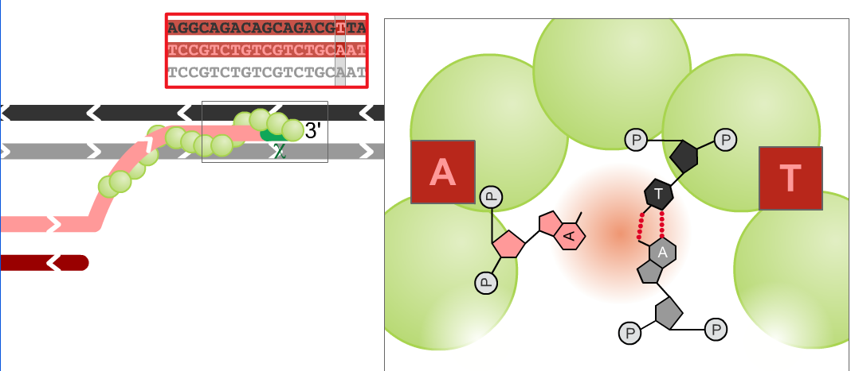
How does the RecA filament sense sequence homology?
Not yet clear, probably by base-pairing interactions (without disrupting base pairing between two strands in the 2 site) probably through base flipping
Match of 15 bp sequence is sufficient signal for RecA to trigger exchange
Notes:
Once a region of base-pair complementarity is located, RecA promotes the formation of a stable complex between these two DNA molecules
The RecA-bound 3-stranded structure is called a joint molecule and usually contains several hundred base pairs of hybrid DNA
It is within the joint molecule that the actual exchange of DNA strands occurs
The strand in the 1° site becomes base-paired with its complement in the DNA duplex bound in the 2° site
Strand exchange requires the breaking of one set of base pairs and the formation of a new set of identical base pairs
Completion of strand exchange also requires that the two newly paired strands be intertwined to form a proper double helix
RecA binds preferentially to the DNA products after strand exchange has occurred and it is this binding energy that actually drives the exchange rxn toward the new DNA configuration

Slide 39
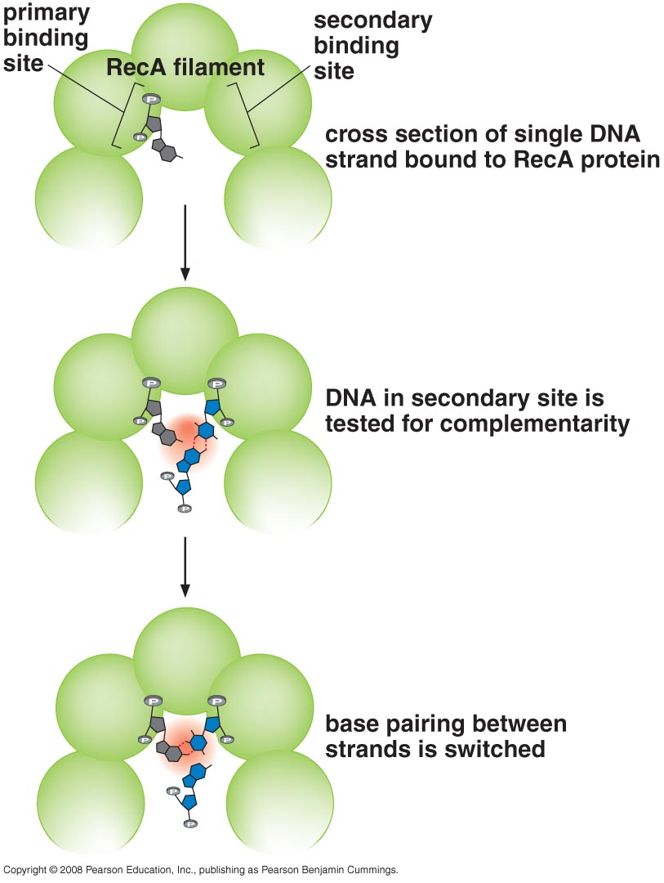
Strand exchange requires the breaking of one set of base pairs and the formation of a new set of identical base pairs
Completion of strand exchange also requires that the two newly paired strands be intertwined to form a proper double helix
Notes:
Strand exchange requires the breaking of one set of base pairs and the formation of a new set of identical base pairs
Completion of strand exchange also requires that the two newly paired strands be intertwined to form a proper double helix

Slide 40
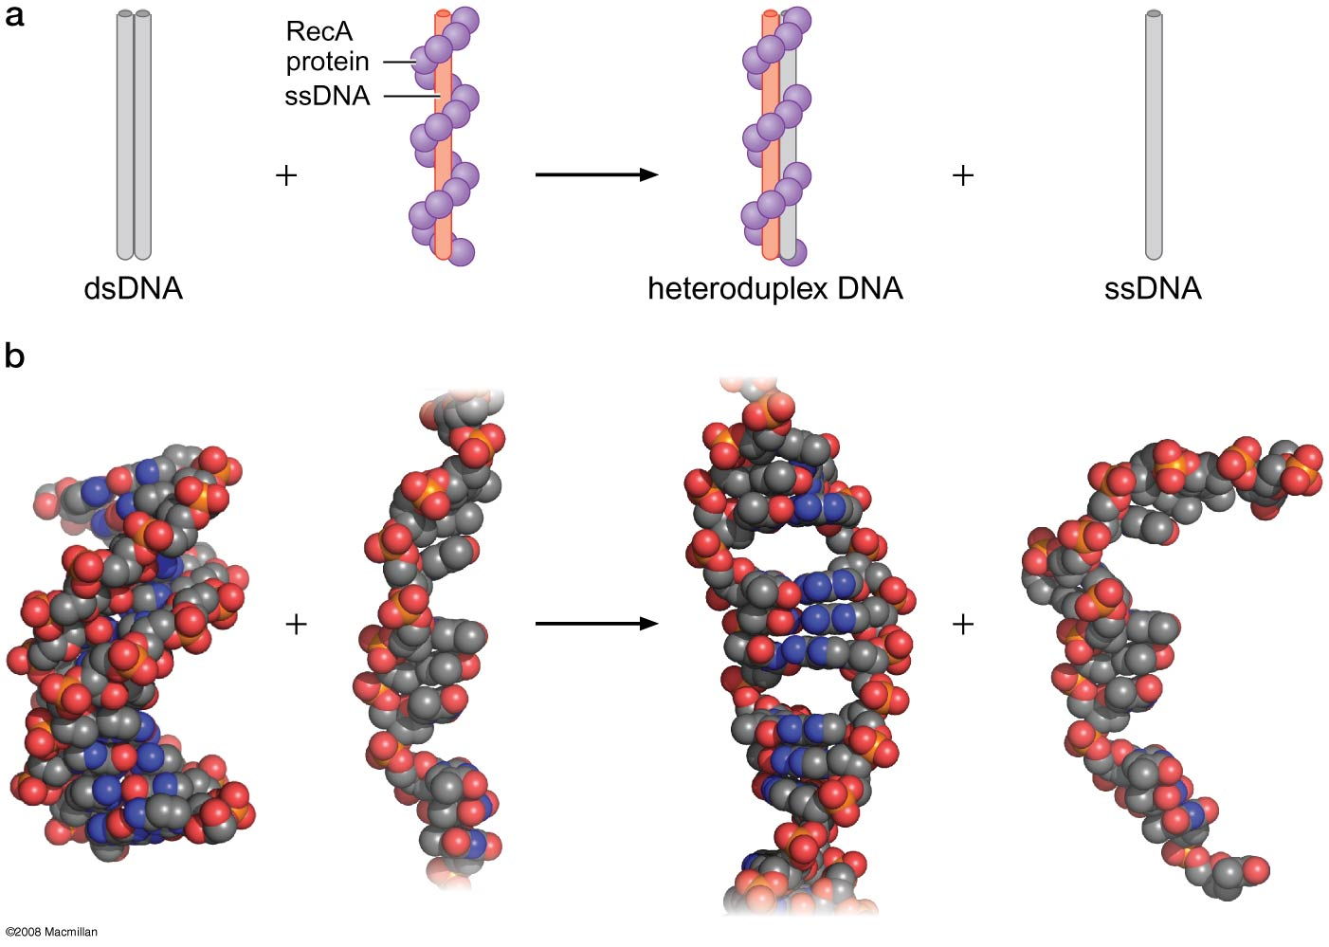
Model of Two steps in search for homology and DNA strand exchange within the RecA Filament
Notes:
40
Figure 11-11
©2008 Macmillan www.nature.com

Slide 41
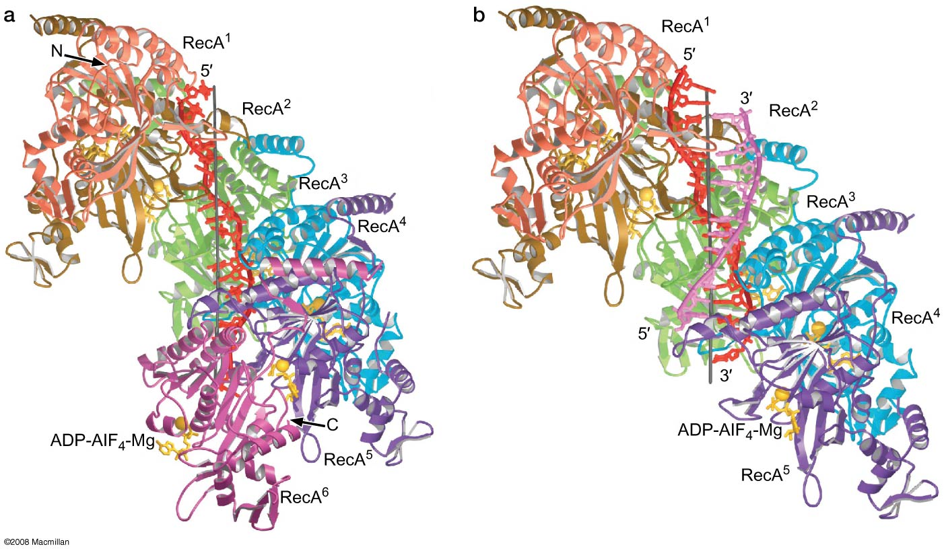
Figure 11-13
RecA ssDNA and dsDNA structures
Notes:
41
Figure 11-13

Slide 42
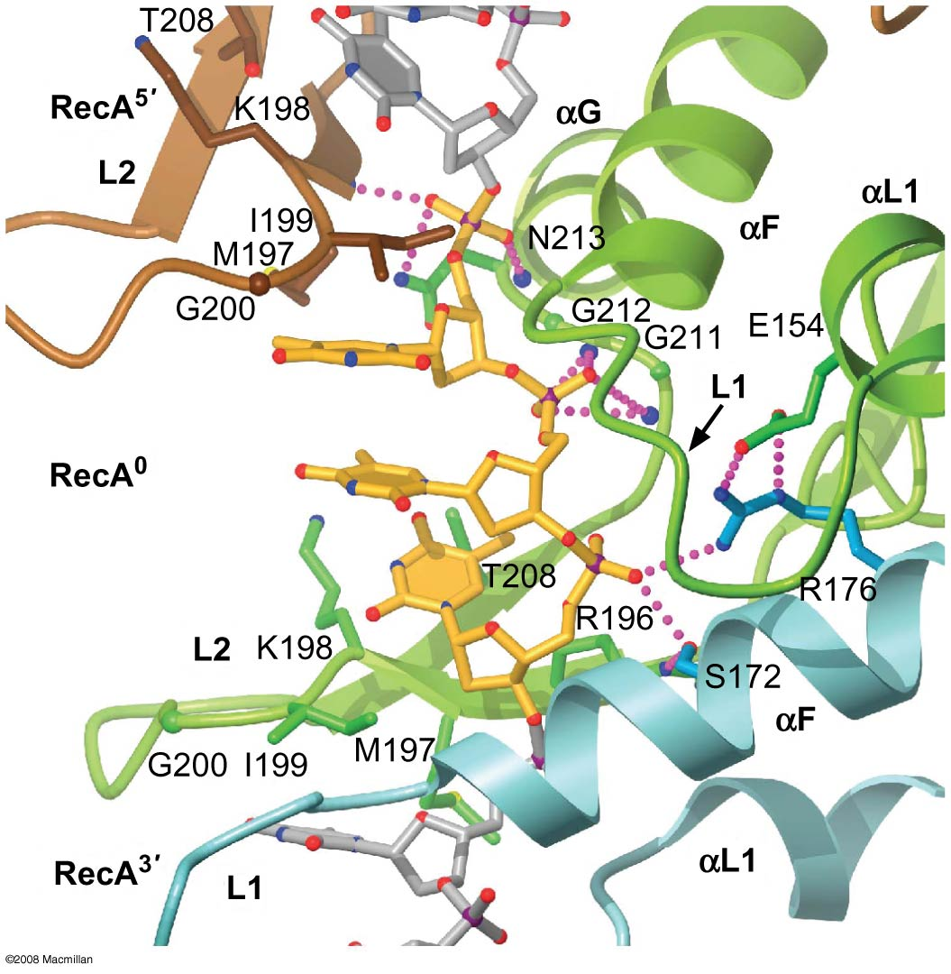
Figure 11-14
RecA with ssDNA
Notes:
42
Figure 11-14
©2008 Macmillan www.nature.com

Slide 43
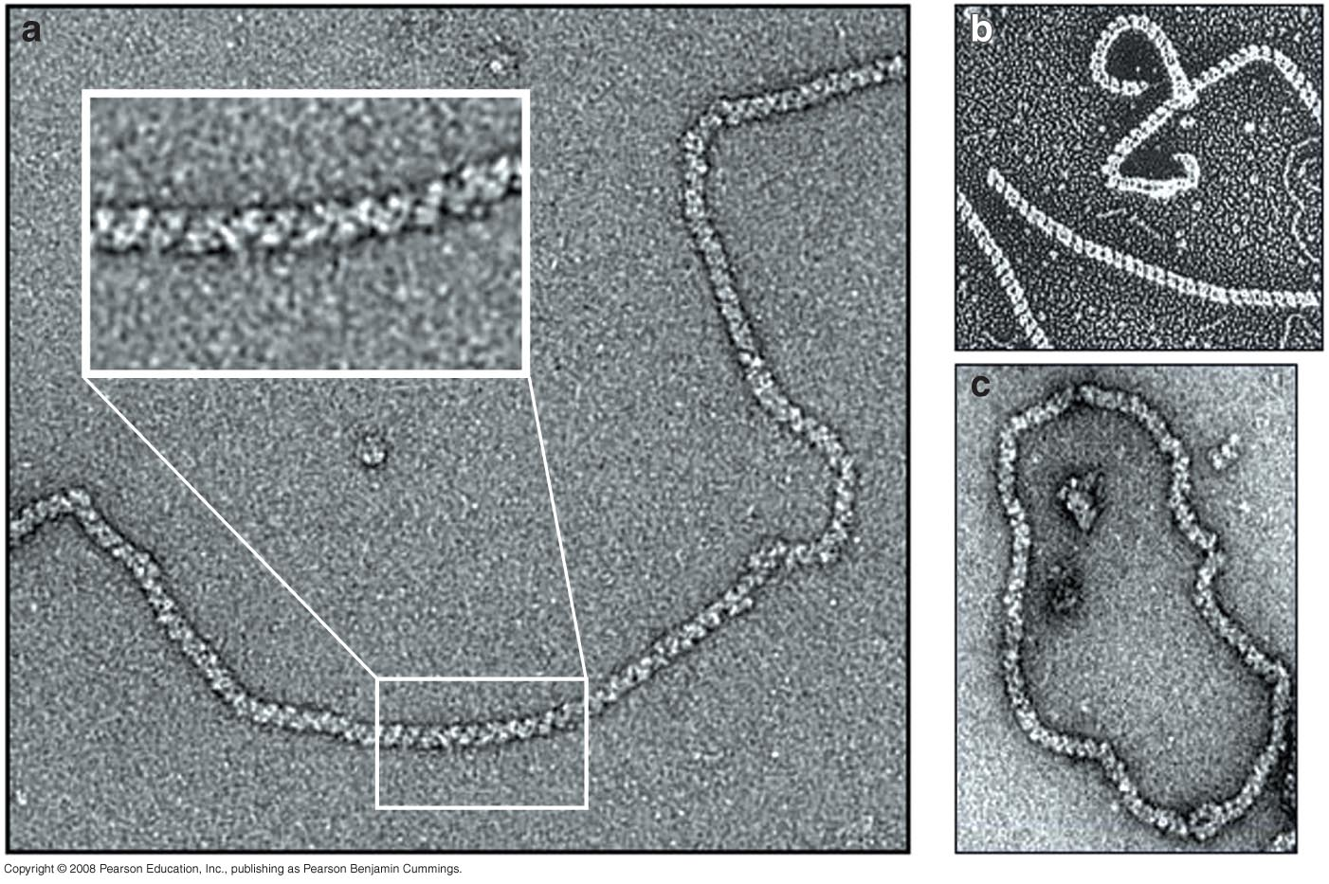
Each homologs are found in all organisms
Human Rad51
E.coli RecA
Archaeoglobus fulgidus RadA

Slide 44
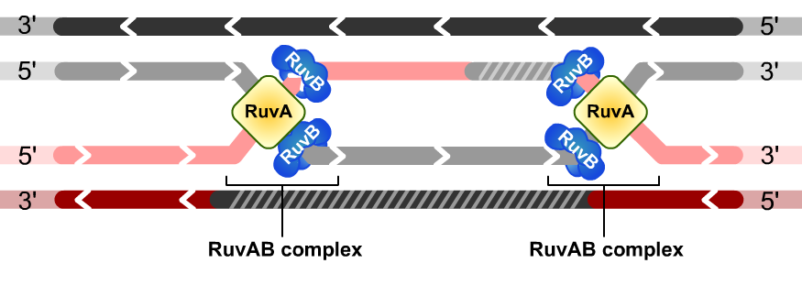
RuvAB Complex specifically recognizes Holliday junctions and promotes branch migration
RuvA
Recognize Holliday junction (regardless of DNA sequence)
Recruits RuvB
RuvB
Hexameric ATPase that provide energy to drive the exchange of bp that moves the DNA branch rapidly and in one direction
* Movement of the site of this branch requires exchange of DNA base pairs between the two homologous DNA duplexes
Notes:
After the strand invasion step of recombination is complete, the two recombining DNA molecules are connected by a DNA branch known as a Holliday junction
Movement of the site of this branch requires exchange of DNA base pairs between the two homologous DNA duplexes

Slide 45
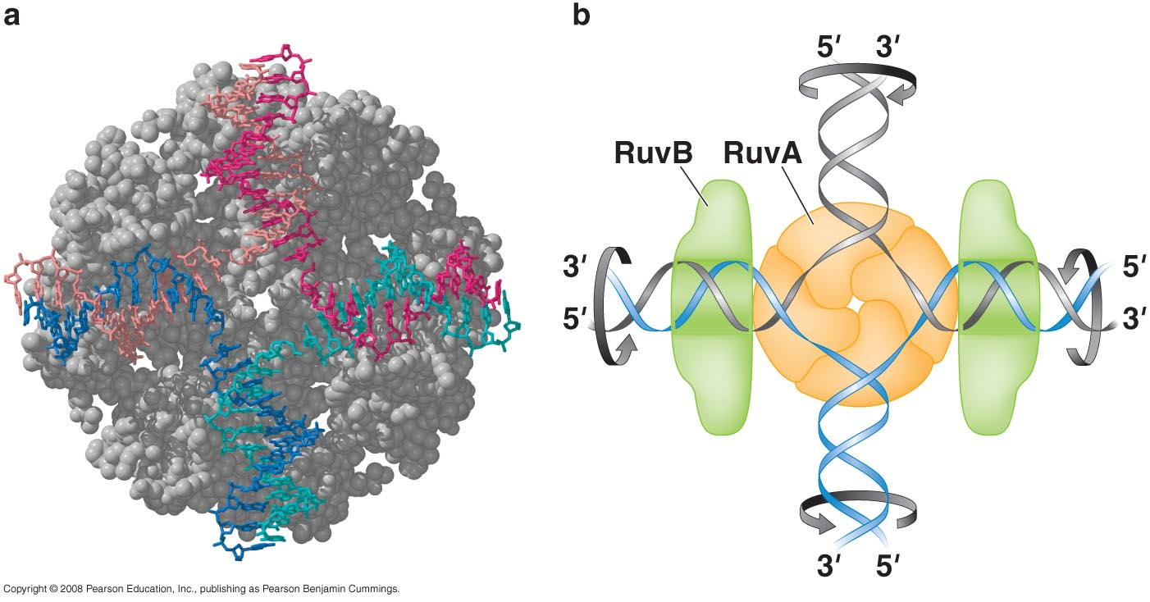
High resolution structure of RuvA and schematic model of the RuvAB complex bound to Holliday junction of DNA

Slide 46
RuvC cleaves specific DNA strands at the Holliday junction to finish recombination
Resolution by RuvC occurs when RuvC recognizes the Holiday junction-likely in a complex with RuvA and RuvB- and specifically nicks two of the homologous DNA strands that have the same polarity
This cleavage results in DNA ends that terminate with 5 phosphate and 3 OH groups that can be directly joined by DNA ligase
Depending on which pair of strands is cleaved, the resulting ligated products will be either the splice (crossover) or patch type (noncorssover).
Modest sequence specificity for cleavage at sites conforming to 5'A/T-T-T-G/C3' (after 2nd T).

Slide 47
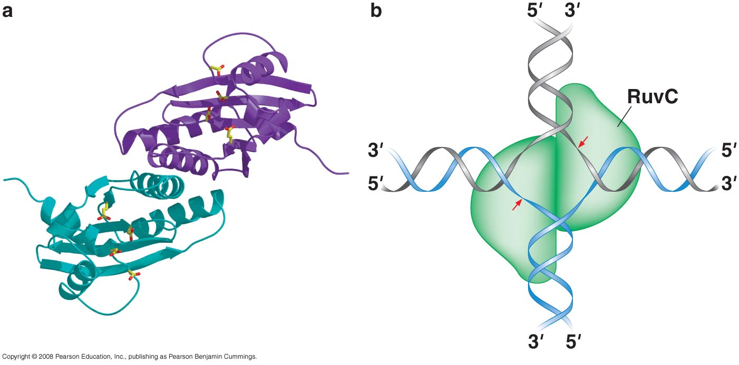
High resolution structure of the RuvC resolvase and schematic model of the RuvC dimer bound to Holliday junction of DNA

Slide 48
Homologous Recombination In Eukaryotes
Notes:
HR is also is required for DNA repair and restarting of collapsed replication forks in euk.
HR is critical for meiosis for proper chr pairing and thus maintaining the integrity of the genome

Slide 49
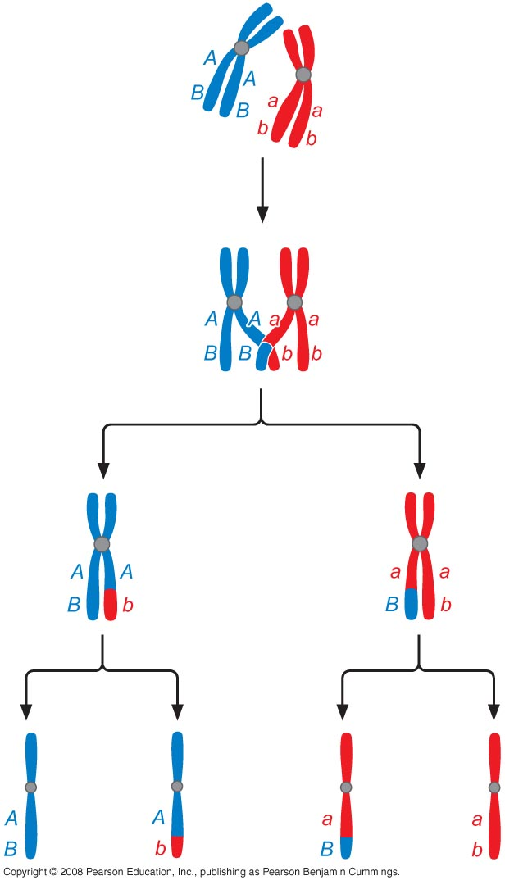
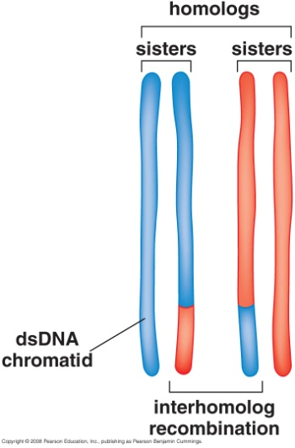
DNA dynamics during meiosis

Slide 50
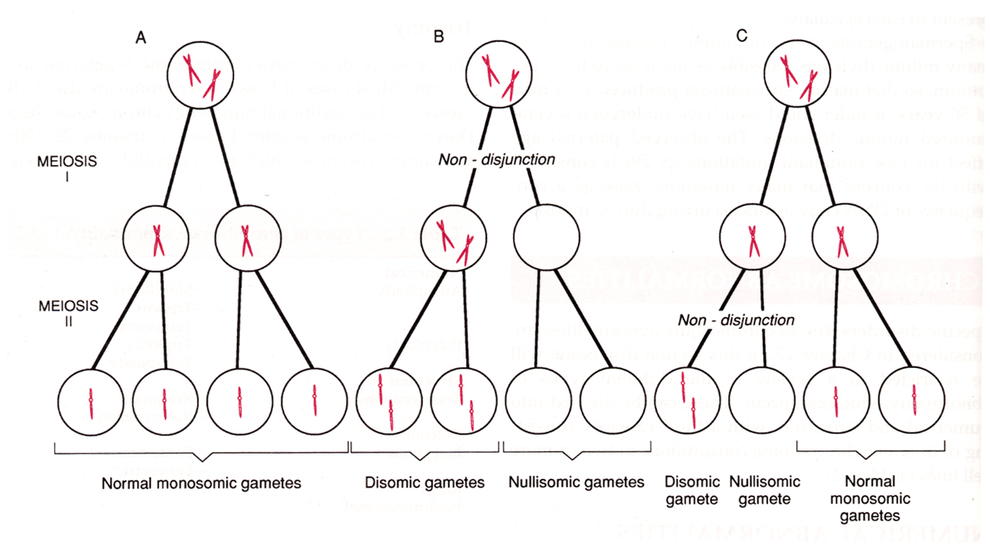
Meiotic recombination prevents non-disjunction (improper segregation of chromosomes)
Notes:
In the absence of recombination, chrs often fail to align properly for the first meiotic division and as a result there is a high incidence of chr loss
The improper segregation of chrs is called nondisjunction
HR events that occur during meiosis are called meiotic recombination frequently give rise to crossing over

Slide 51
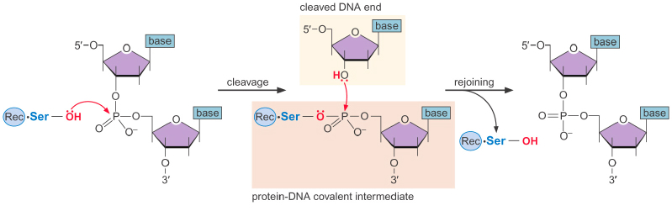
Programmed generation of DSB occurs during meiosis
Turning on expression of SPO11 gene to initiate meiotic recombination
Cuts DNA at many locations with little sequence specificity but at
Very specific time during meiosis
Cuts sites although frequent but not random mostly in less tightly packed DNA such as promoters
Tyr
Tyr
Tyr

Slide 52
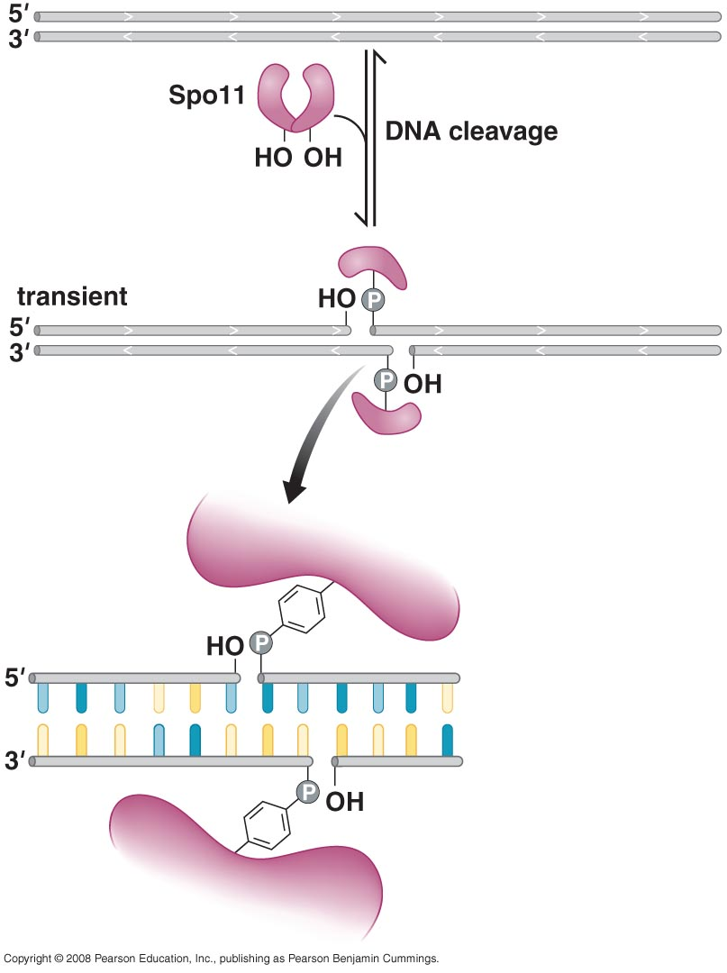
A specific tyrosine in the Spo11 attacks the phosphodiester backbone to cut the DNA and generate a covalent complex between the protein and the served DNA strand
Two subunits of Spo11 cleave the DNA two nucleotides apart on the two DNA strands to make a staggered DSB
Covalent protein-DNA complex has two consequences:
The 5’ends of the DNA at the site of Spo11 cleavage are covalently bound to the enzyme (these are initial sites for DNA processing to create the ssDNA tails required by RecA-like proteins and initiation of DNA strand invasion
Energy of the cleaved DNA phosphodiester bond is stored in the bound protein-DNA linkage and so the DNA strands can be released by a simple reversal of the cleavage rxn
Notes:
Spo11 shares this DNA cleavage mechanism with DNA topoisomerase and site-specific recombinase

Slide 53
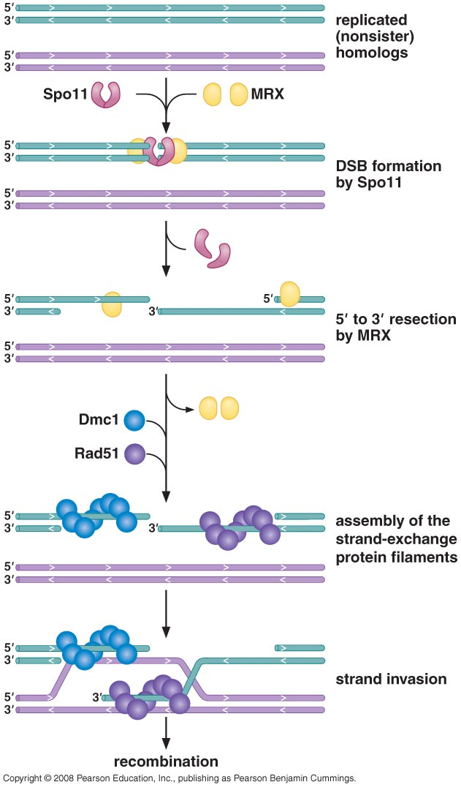
MRX processes the cleaved DNA ends for assembly of the RecA-like exchange proteins
MRX is composed of Mre11, Rad50 and Xrs2
Processing of the DNA at the break site occurs exclusively on the DNA strand that terminates with a 5'-end (the one attached to Spo11) 5' →3'
Notes:
The MRX-enzyme complex is responsible for DNA processing event
This complex, although not homologous to RecBCD , is also a multisubunit DNA nuclease
The MRX-dependent 5' →3' resection generates the long ssDNA tails with 3’ ends that are often 1 kb or longer

Slide 54
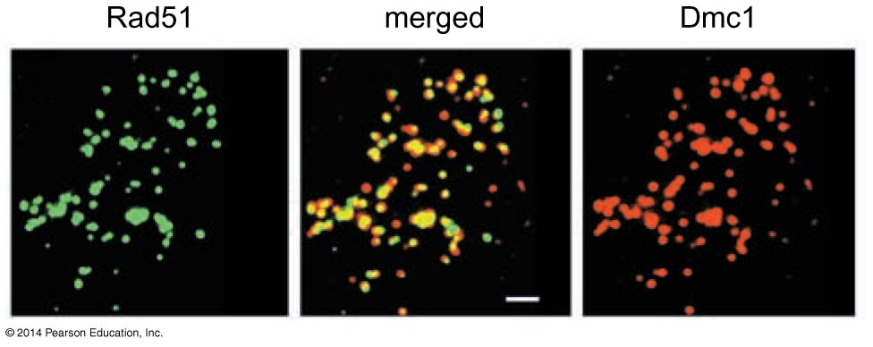
Dmc1 is RecA-like protein that specifically functions in meiotic recombination
Rad51 is widely expressed in cells dividing mitotically and meiotically but Dmc1 is expressed only as cells enter meiosis
Strand exchange during meiosis occurs between a particular type of homologous DNA partner
Dmc1-dependent recombination is preferentially between the nonsister homologous chromatids rather than between sister chromatids.

Slide 55
Many proteins function together to promote meiotic recombination
Many additional proteins appear to interact with the known recombination enzymes in a large protein-DNA complex known as recombination factories
Rad52 functions to promote assembly of Rad51 DNA filaments by antagonizing the action of RPA (SSB protein). Also, promotes the annealing and base pairing of complementary ssDNA molecules
BRCA2 also participates in Rad51-meidated DSB repair
Rad51C and XRCC3 contain Holliday junction resolvase activity
Noncrossover recombination can have genetic consequence such as giving rise to a gene conversion event. It happens when an allele of a gene is lost and replaced by an alternative allele.

Slide 56
Mating Type Switching

Slide 57
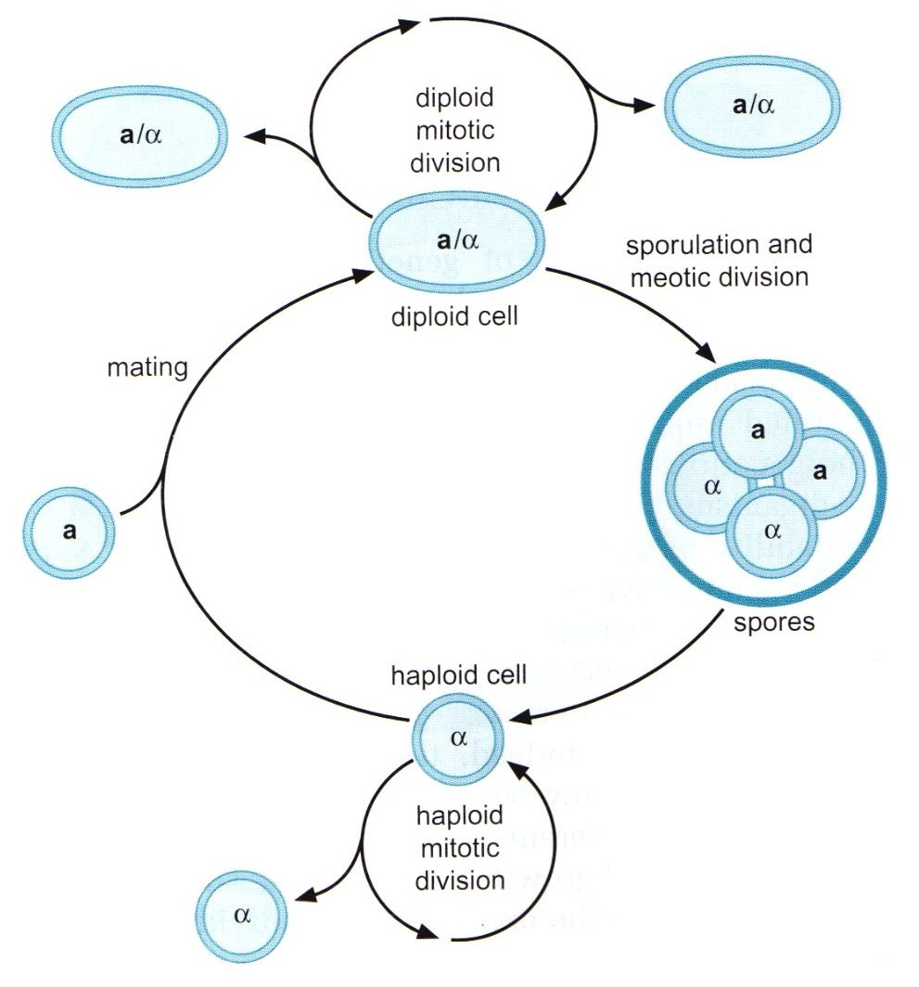
Control of Gene Expression Mating-Type Switching S. Cerevisiae
Exist in any of 3 cell types:
Haploid
a
α
Diploid a/α
The mating-type genes encode transcriptional regulators. These regulators control expression of target genes whose products define each cell type
The mating type genes expressed in a given cell are those found at the Mating Type Locus (MAT locus) in that cell.
Notes:
HR can serve to change the DNA sequence at a specific chromosomal location
Used sometimes to regulated gene expression

Slide 58
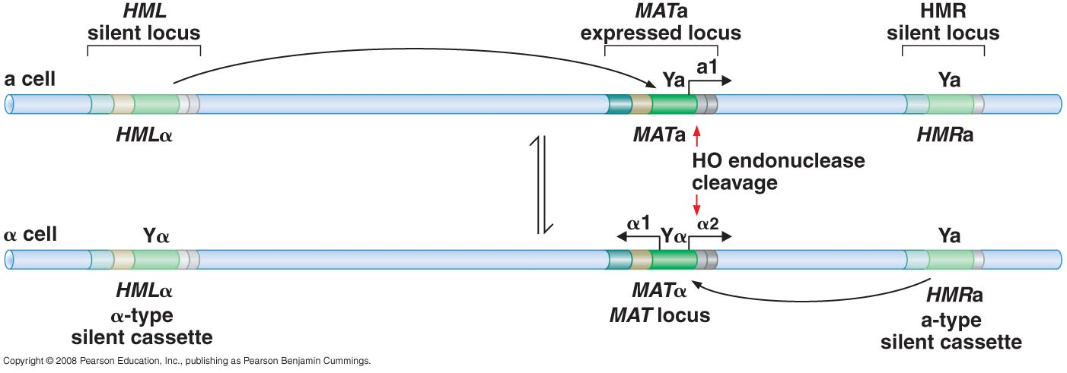
Genetic loci encoding mating-type information
Mating type switching takes place between two sister chromatids (after replication) in the mother cells, the aim is that only haploid cells with different type can mate
Notes:
Mating type switching takes place between two sister chromatids (after replication) in the mother cells, the aim is that only haploid cells with different type can mate (a and alpha) so mother cell need to switch its type so that it can mate with its bud if needed

Slide 59
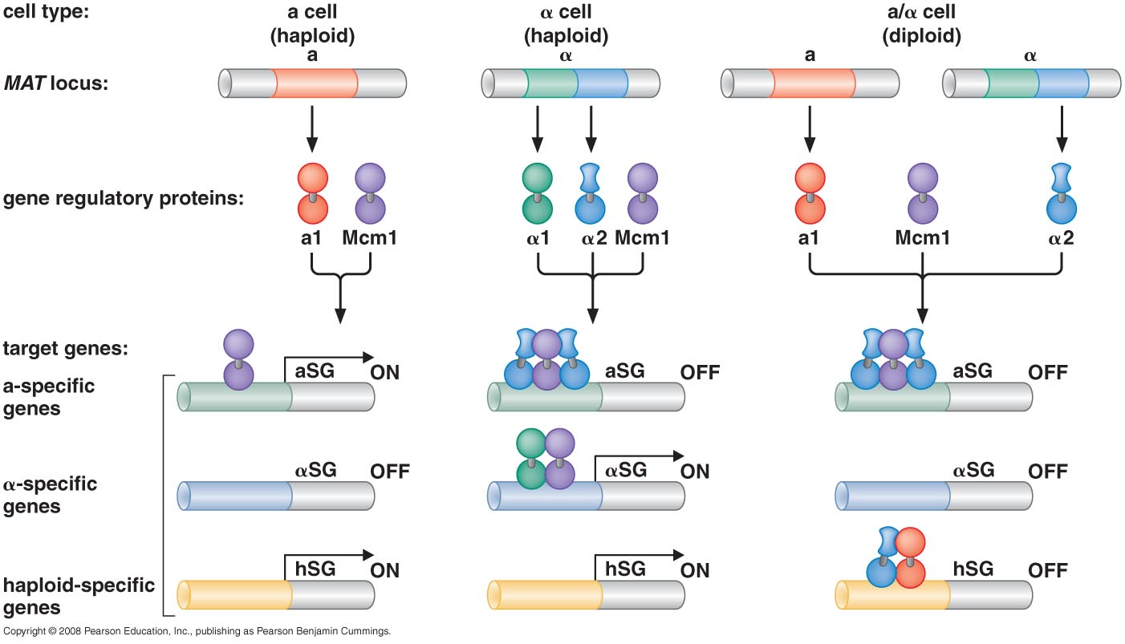
Example of combinatorial activation in mating type gene in S. cervisiae
Notes:
A1 turn on different genes (50 genes) and alpha 1 and 2 activate and suppress different group of genes so that each cell type have different phenotype based on the genes that are turned on or off

Slide 60
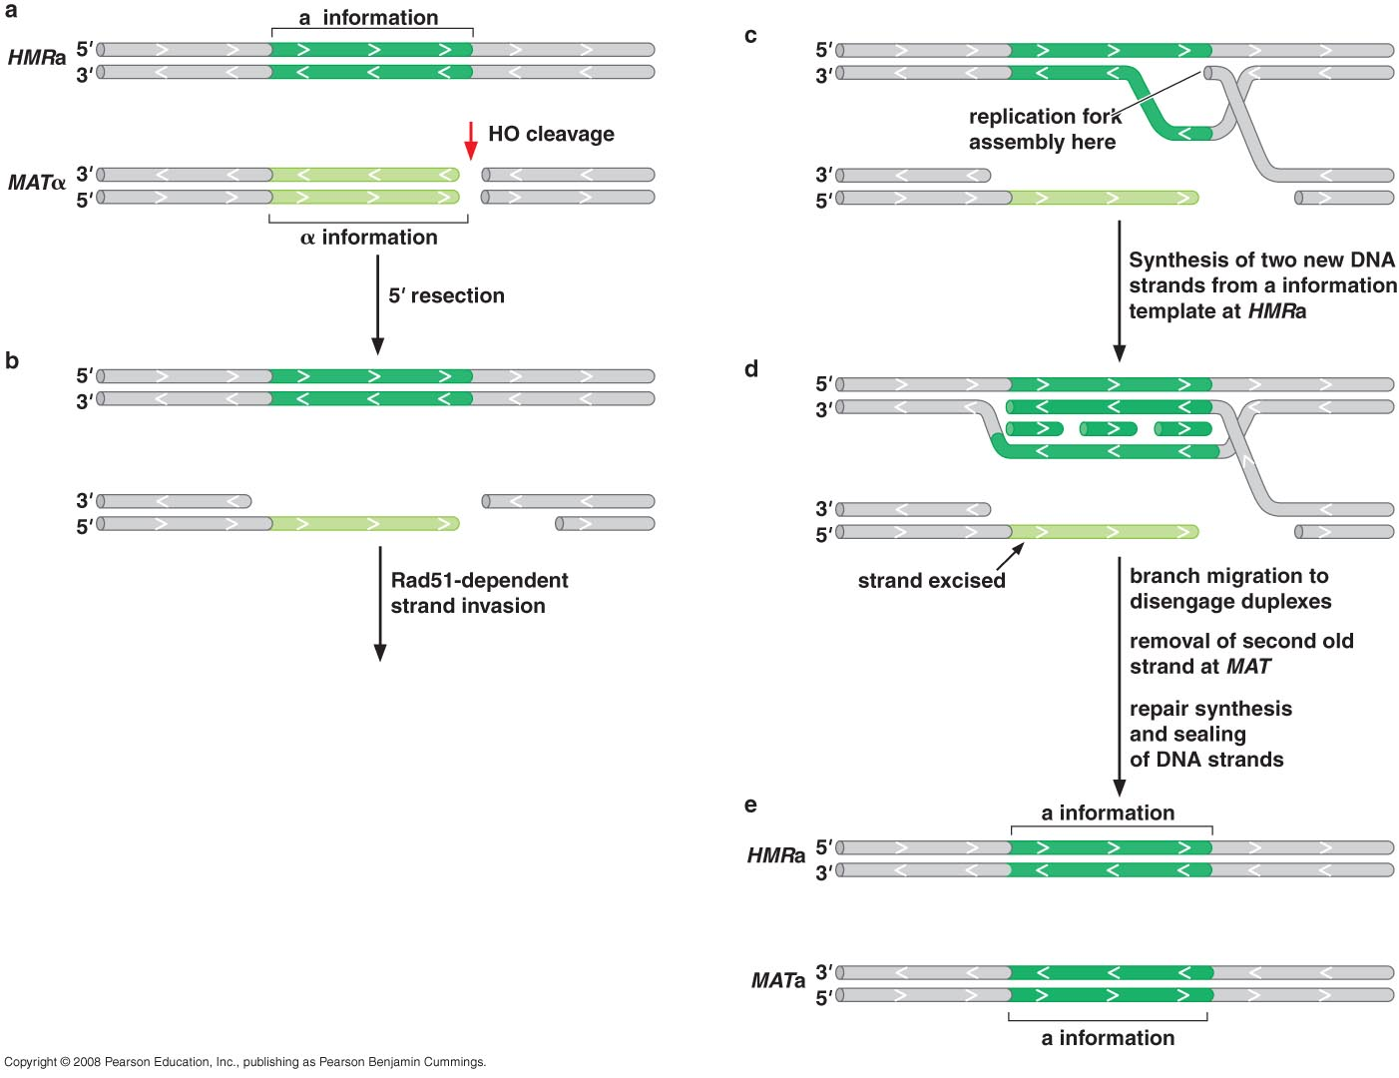
Mating – Type Switching
HO endonuclease
A sequence-specific endonuclease (only at MAT loci)
MRX protein: 5`→3` resection of the DNA at the site of HO-induced break
Notes:
The switch requires the transfer of genetic information from the HM sites to the MAT locus via homologous recombination
Once the long 3’ ssDNA tails have been generated, this DNA becomes coated by the Rad51 and Rad52 proteins

Slide 61
Rad51 & Rad52
Strand invasion
Matching (search for homologous regions)
No crossing over (crossover products never observed)
No Holliday Junction
Notes:
Mating-type switching is unidirectional i.e. sequence information is moved to the MAT locus from HMR and HML but information never goes in the other direction (HO endonuclease cannot cleave its recognition sequence at either HML or HMR.

Slide 62
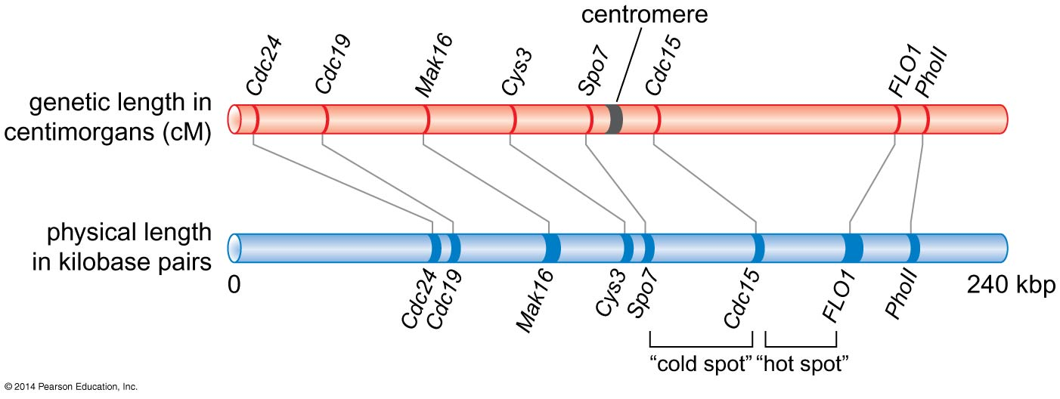
Figure 11-27
Comparison of the genetic and physical maps of a typical region of
a yeast chromosome.
Notes:
62
Figure 11-27

Slide 63
synthesis-dependent strand annealing (SDSA)
No Holliday Junction
Formation of replication fork
Excision of 3` strand

Slide 64
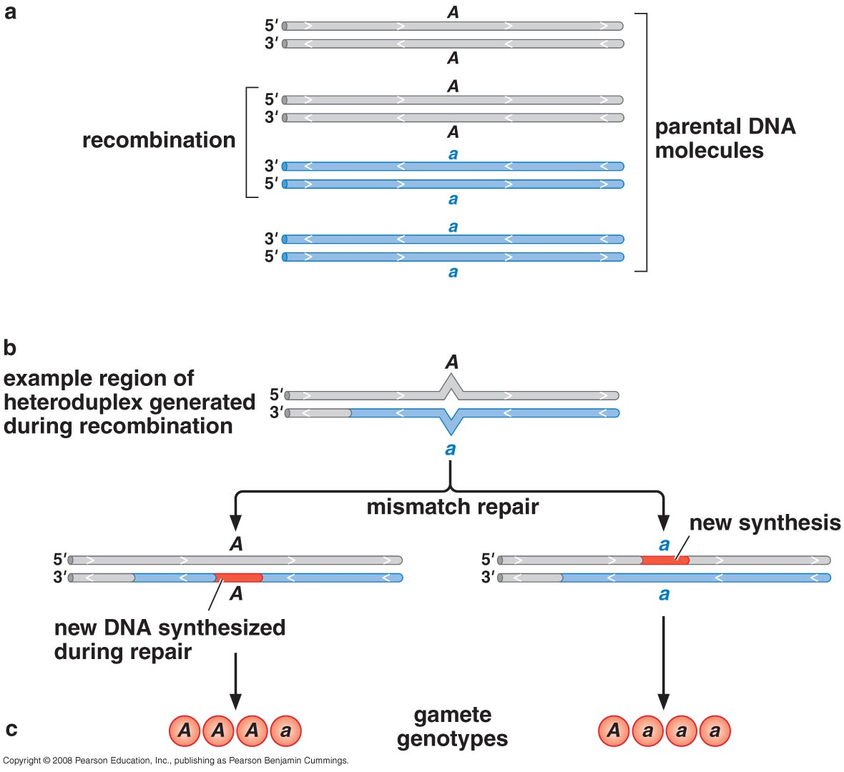
Gene conversion
Close to cut site
Within exchange area

Slide 65
END

